Slide 1

DIAL DETECTIVE
BY
45-Madhuri Patil
47-Durva Patkar
53-Vaishnavi Rawate
UNDER THE GUIDANCE OF
(Prof. Sumedh Pundkar)

Slide 2


INTRODUCTION
Dial Detective is an advanced system designed for phone number validation and data extraction, offering essential details like location, network provider, time zone, and spam detection. It is crucial for fraud detection, security, and verification, helping organizations and individuals identify potential threats, prevent scams, and ensure reliable communication.

Slide 3
LITERATURE SURVEY
Author(s) & Year | Abstract | Techniques
Tejas Kulkarni, Aditya Siddhu, Durgesh Chauhan, Bharati Dhomne, Abhishek Patil (2022) | The Phone Locator system tracks mobile numbers, providing location, network details, and regional information while ensuring privacy. It operates nationwide and identifies active numbers or complaints. | Network Tracking – Identifies provider & location. Address Tracking – Estimates registered address. KNN Algorithm – Finds closest match. Real-time Retrieval – Updates tracking data.
Technology | Limitations | Conclusion
OpenCage API – Converts location to coordinates. Phonenumbers – Validates phone details. Flask – Web interface. Google Geocode API – Improves location accuracy. | Signal Issues – Affects accuracy. High Battery Use – GPS drains power. Internet Needed – For updates. Public Data Dependent – Limits accuracy. | Efficient mobile tracking without costly GPS devices. Relies on GPS, internet, and network. Future focus: better accuracy, lower power use.

Slide 4
LITERATURE SURVEY
Author(s) & Year | Abstract | Techniques
Satvik Rana , Ayush (2023)​ | Mobile tracking supports security and navigation. This project explores GPS, triangulation, and Wi-Fi, addressing privacy and accuracy challenges. AI can improve future precision. | GPS – Satellite-based tracking. Triangulation – Uses network towers. Wi-Fi – Enhances accuracy. IP Geolocation – Tracks via internet. Hybrid – Combines methods.
Technology | Limitations | Conclusion
GPS/GNSS – Outdoor tracking. Cellular – Uses tower signals. Wi-Fi/Bluetooth – Indoor tracking. AI/ML – Enhances accuracy. Big Data – Processes location data. | Accuracy – Affected by signals. Privacy – Risk of unauthorized access. Legal – Strict tracking regulations. Connectivity – Requires GPS/internet. Battery – High power usage. | Mobile tracking aids security but has accuracy and privacy issues. AI and data security will improve efficiency.

Slide 5
LITERATURE SURVEY
Author(s) & Year | Abstract | Techniques
Allison McDonald, Tamy Guberek, Carlo Sugatan, Florian Schaub (2021)​ | Phone numbers enable authentication but risk privacy and fraud. This study examines threats and security solutions. | Validation – Confirms active numbers. Encryption – Secures data. MFA – Adds OTP security. Fraud Detection – Identifies threats. Recycling Management – Prevents reuse risks.
Technology | Limitations | Conclusion
AI/ML – Detects fraud. Blockchain – Prevents unauthorized access. Authentication – Secures accounts with OTPs. Mobile Data/GPS – Verifies ownership & location. | Privacy – Spam & tracking. Security – Fraud risk. Recycling – Data leaks. Network – Needs stable connection. | Phone numbers pose risks; AI & encryption improve security.

Slide 6

PROBLEM STATEMENT
The Dial Detective system addresses the challenge of identifying unknown numbers, reducing the risk of fraud and spam calls, and providing a secure and efficient tracking solution. However, number tracking comes with challenges such as privacy concerns, limited access to real-time data, and accuracy issues, which must be carefully managed to ensure reliable and ethical usage.

Slide 7
METHODOLOGY
Requirement Analysis – Define input, validation, and output features.
System Design – Create a structured flow:
User Input → Validation Module → Feature Processing → Output Module
3. Implementation – Validate number, extract details (Country Code, Carrier, etc.), and display results.
4. Testing – Verify accuracy, handle invalid inputs, and ensure smooth processing.
5. Deployment – Launch, monitor performance, and refine as needed.

Slide 8


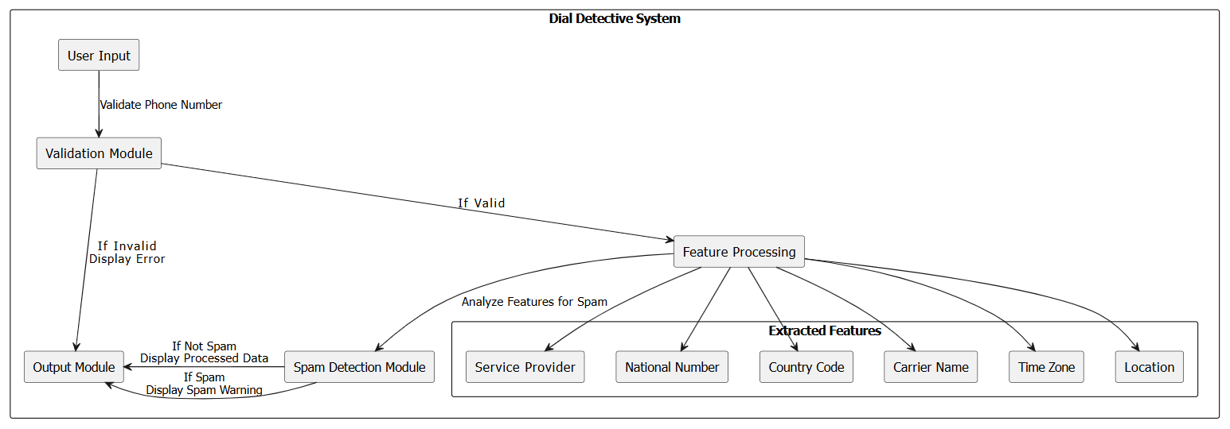
BLOCK DIAGRAM

Slide 9


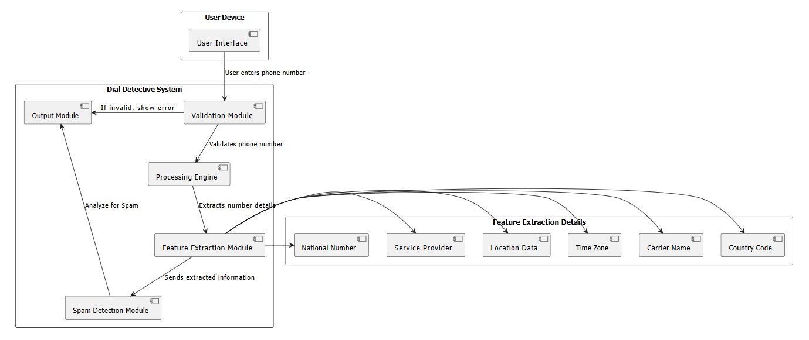
ARCHITECTURE OVERVIEW

Slide 10
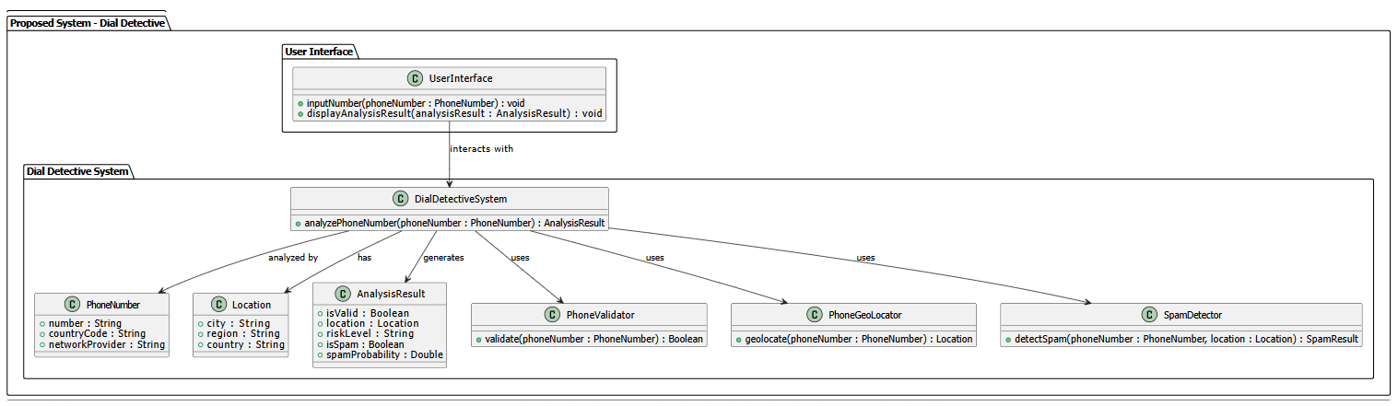
PROPOSED SYSTEM

Slide 11




ALGORITHM / FRAMEWORK
KNN Algorithm Steps:
1. Load a dataset of known spam and legitimate numbers.
2. Convert phone number details into features (e.g., carrier, country, number pattern).
3. Compare new phone number features with stored data.
4. If similar to spam numbers, classify as spam; otherwise, classify as safe.
The Dial Detective system is based on:
• Phonenumbers Library – Extracts phone number details.
• Machine Learning (KNN) – Determines if a number is spam.

Slide 12


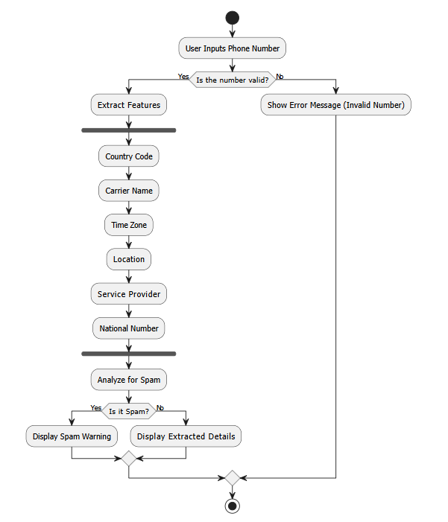
FLOWCHART

Slide 13


OPERATING ENVIRONMENT
• Platform: Python application (future enhancement: user-friendly GUI).
• Software Requirements:
Python Libraries: phonenumbers, Scikit-learn (for ML).
• Hardware Requirements:
Any system with Python 3.x installed (Windows/Linux/macOS).

Slide 14


IMPLEMENTATION DETAILS
Backend: Validates numbers using phonenumbers, applies ML (KNN) for spam detection, and processes data locally.
Frontend: Simple interface for input and displays carrier, location, spam status, and time zone.

Slide 15
CONCLUSION
Dial Detective provides phone number validation and spam detection, ensuring a fully independent and reliable system without external services. It enhances fraud prevention, security, and verification, making communication safer. Future enhancements will focus on improving accuracy, developing a mobile app version, and enhancing machine learning models for better performance.

Slide 16
REFERENCES
https://www.irjmets.com/uploadedfiles/paper/issue_6_june_2022/25455/final/fin_irjmets1654458194.pdf
https://www.questjournals.org/jses/papers/Vol9-issue-5/09054854.pdf
https://amcdon.com/papers/phonenumbers-chi21.pdf
https://www.scribd.com/document/633736258/PHONE-TRACKING-using python

Slide 17
THANK YOU

